Slide 1
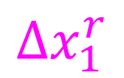
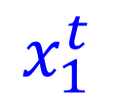

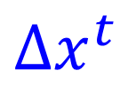
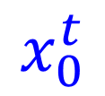
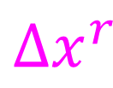
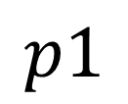
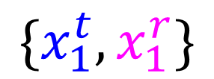
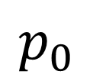
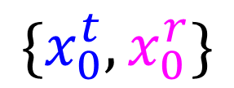
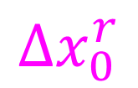
$$Δx_{0}^{r}$$
$$\{x_{0}^{t},x_{0}^{r}\}$$
$$x_{0}^{t}$$
$$p_{0}$$
$$Δx^{t}$$
$$Δs$$
$$p1$$
$$x_{1}^{t}$$
$$Δx^{r}$$
$$\{x_{1}^{t},x_{1}^{r}\}$$
$$Δx_{1}^{r}$$

